Slide 1
WorldVisitz Mobile Application Agile Delivery Launch
Agile Onboarding - Presentation for the Agile Team
Presented by: Shaikat Majumder
© 2019 Udacity. All rights reserved.

Slide 2
Onboarding the Team

Slide 3
Agile Benefits for the Team
Allow for Increased flexibility in teams
Allow for greater collaboration
Faster time for launching product to the market
More Transparency
Allows for continuous Improvements
Notes:
Allow for Increased flexibility in teams via allowing for more flexible planning and collaboration over waterfall approach
Allow for greater collaboration through reviews and daily standups
Faster time for launching product to the market via providing working software through iterative cycles,
More Transparency by allowing and promoting transparency and making the work visible at higher frequencies for the stakeholders
Allows for continuous Improvements via regular retrospectives and feedbacks while allowing the team to thinks of improvements and do experiments to find out what suits them the best for quality work.

Slide 4
Agile Practice

Slide 5
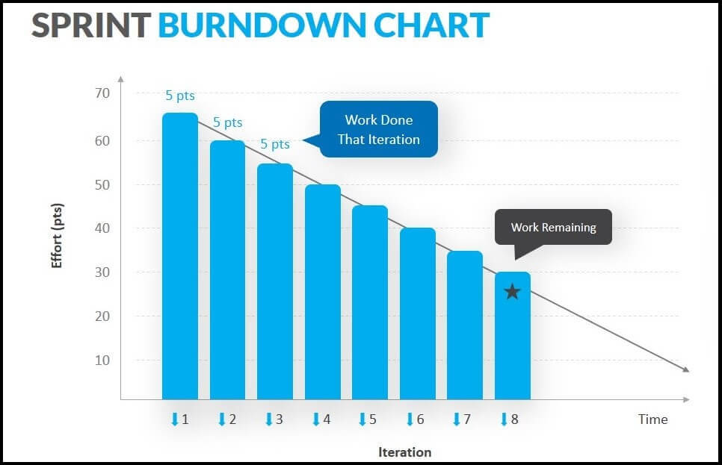
Recommendations for Information Radiators
Information Radiator 01: Burndown Chart:
A burndown chart shows the amount of work that has been completed in an epic or sprint, and the total work remaining.
Benefit of the Information Radiator
Helps in understanding the probability of the work being completed,
Keeps the team in track on the sprint by visualizing the effective down being done
Notes:
Burndown Chart is an extremely good information radiator for the team to stay aligned on the amount of work that they are currently ruminating with. This is to motivate the team and see if they can complete the tasks assigned in the given time. Also this helps immensely in the upcoming sprint planning.

Slide 6
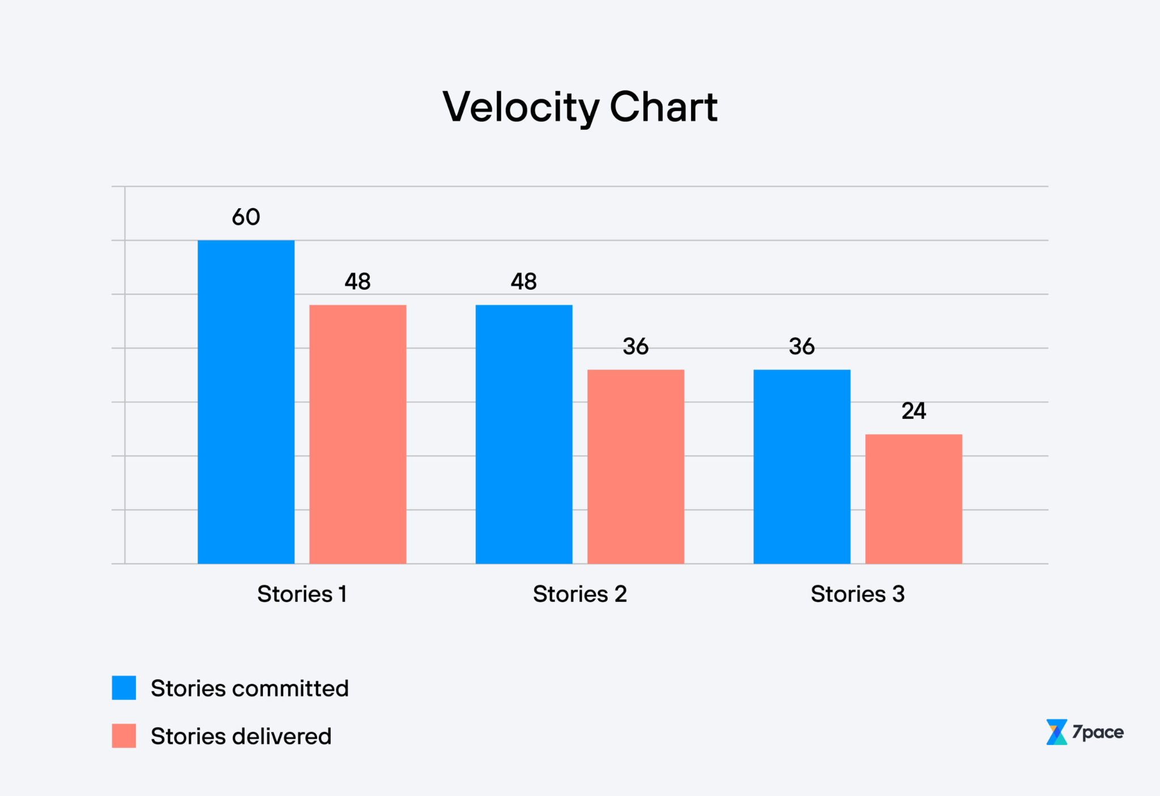
Recommendation for Information Radiators
Information Radiator 02: Velocity Chart
It is an overview of how much has been delivered each sprint
Benefit of the Information Radiator
Can be used as a suitable indicator to find out team burnout
Helps in understanding the teams capacity and capabilities and helps in better allocating work for the upcoming sprints
Notes:
Velocity Charts are extremely important as they help identify the efficiency of the team while at the same time giving us a reference to compare the team performance month on month. Any burn downs in the team or friction can be directly linked to changes in the velocity and be identified earlier and necessary steps can be taken.

Slide 7
Ceremony Schedule & Each Agenda
Event Name | Agenda | Frequency | Duration | Purpose
Sprint Planning | The Scrum Master facilitates this meeting to select items from the backlog for the upcoming sprint according to the team capacity | At the beginning of each sprint | 8 hours for a 30 day sprint | Planning the upcoming sprint
Daily Scrum | Team members to update the team about their tasks and team to remove any blockers as identified by the team | Held Daily or Everyday | 15 minutes daily | Updating the team on daily works
Sprint Review | Presentation of work completed during the sprint, reviewed against the product goal and feedbacks given by the stakeholders | Held at the end of every sprint | 4 Hours for a 30 day sprint | Reviewing the work done by stakeholders
Sprint Retrospective | Reflection of previous sprint, prioritise opportunities for improvements and create new items for backlog for next sprint | Held after the sprint review and before the next sprint | 3 hours for a 30 day sprint | Finding opportunities to improve
Backlog Refinement | Team to review backlog items for making sure the backlog items are well defined, understood by the team and ready for sprint planning sessions. | Conducted as per requirements | Around 3 days for a 30 day lng sprint | Improving the backlog for next sprints
If you are using Scrum, you should follow the Scrum Guide

Slide 8
High Performing Agile Teams

Slide 9
Team Composition and Role Assignments
Scrum Role | Role Assignment | Skills They Have
Scrum Master | Jane Doe (Project Manager) | Project Management, Team Communication
Product Owner | John Smith (Product Manager) | Product Management, Requirement Understanding, Interpersonal Communication, Research Skills
Scrum Team | Developers → Jim Brady (USA), Nathan Connor (USA), Venkat Ragu (India), Ali Khan (India) Kathy Qualls (Tester), james Cowx ( Designer) | Developers → Technical Expertise, technical prowess,engineering skills, software development skills Tester → Software Testing Skills Designer → UX Design Knowledge and Skills
Stakeholder | Jerry Holden (Business Analyst), Holly Vogt (Subject Matter Expert) | Business Analyst → Requirement Analysis, Research Skills Subject matter Expert → Business Skills about Application,
Notes:
I am recommending that the whole team should be involved in the scrum methods. Jane Doe should be the scrum master due to being the project manager and having suitable management skills. John Smith should be the Product Owner due to having the highest understanding of the requirements of the product and the business needs. The stakeholders should be the business analyst and the subject matter expert as they do not have direct involvement in the development of the product. The rest of the team should be the scrum team doing the development, design and testing works.

Slide 10
Appendix 1 - Skill Gaps
Name if Team Member | Skill Gap, Weakness or Anti patterns Identified
Jane Doe | Lack of Empathy and Team Collaboration
Jim Brady and Nathan Connor | Lack of handling advanced technical requirements
John Smith | Lack of team communication skills, blocked by facilities
All Developers | Lack of consistent coding standards, lack of trust
Jerry Holden | Requirements are frozen early by the analyst
James Cowx | Customer feedbacks received late, or after launch
Holly Vogt | Prefers one to one call over team meeting for proper knowledge transfer

Slide 11
Appendix 2 - Training & Coaching Plan
Training Topic | Participants
Empathy and Team Communication | Jane Doe, John Smith, Jerry Holden
Interpersonal Communication | John Smith (One to One Coaching)
Requirement handling + Knowledge transfer facilitation | Jim Brady, Nathan Connor, Venkat Ragu, Ali Khan
Scrum Methodologies Training | The Complete Team
Team Management | Jane Doe (One to One Coaching)
Notes:
I am recommending both one to one coaching and team coaching based on the skill gaps, anti patterns and weaknesses exhibited by each participants according to the case study. It is to be kept in mind that some trainings should be done by the whole team and members can be added to a particular training based on specific requests from the members. Trainings should also be continued on a rolling basis.

Slide 12
Thank You

